Slide 1
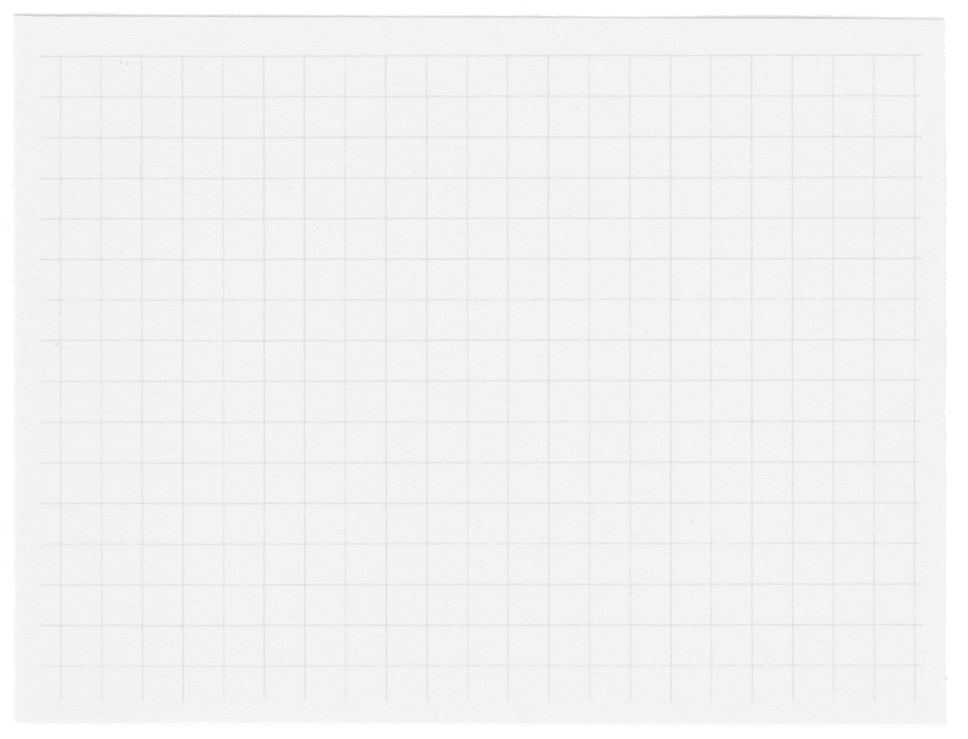
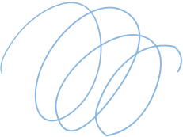
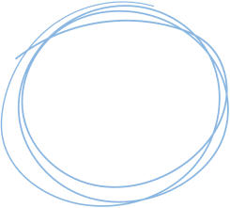

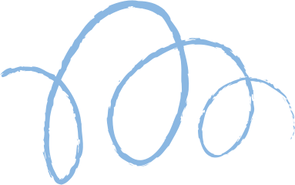









Int.AI
Neural Pirates

Slide 2
Problem Statement
Communication gap between designer and consumer
Unable to Visualize Design Ideas
Time Consuming Design Iterations

Slide 3
Solution
Create Multi Model Image and Prompt to Actual Design Image
Stable Diffusion, Control Net, Transformers
User Interactive Web App

Slide 4
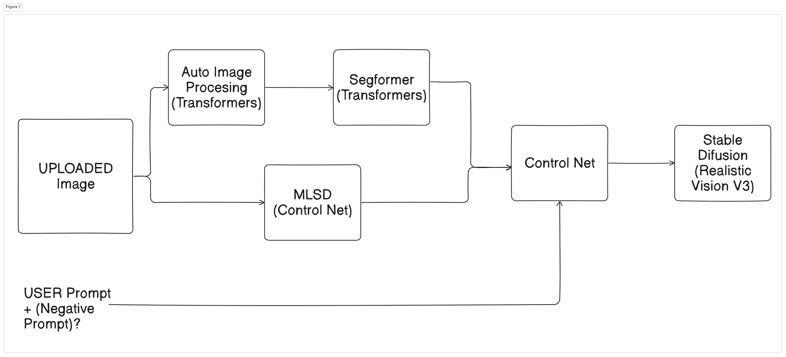

Slide 5
Thank You

